Slide 1
Table Structure Recognition

Slide 2
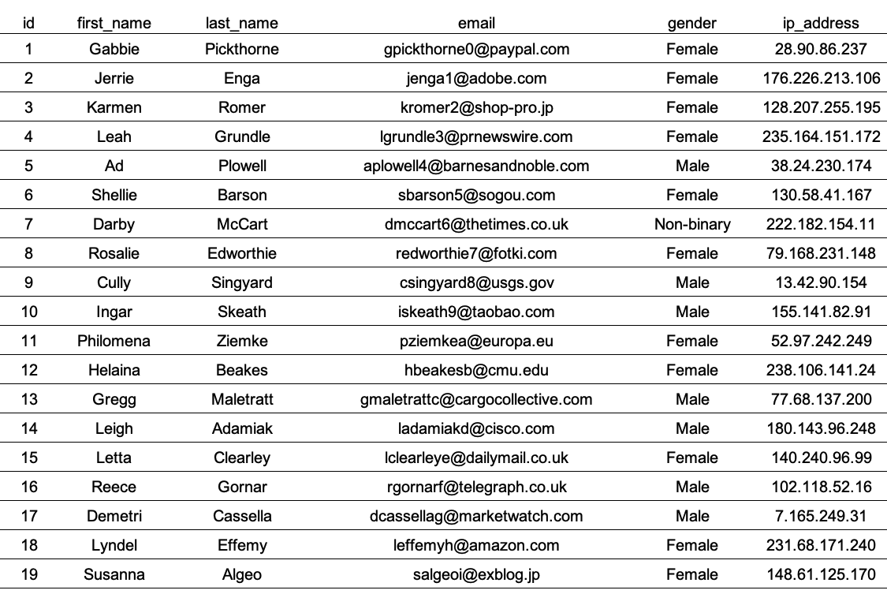
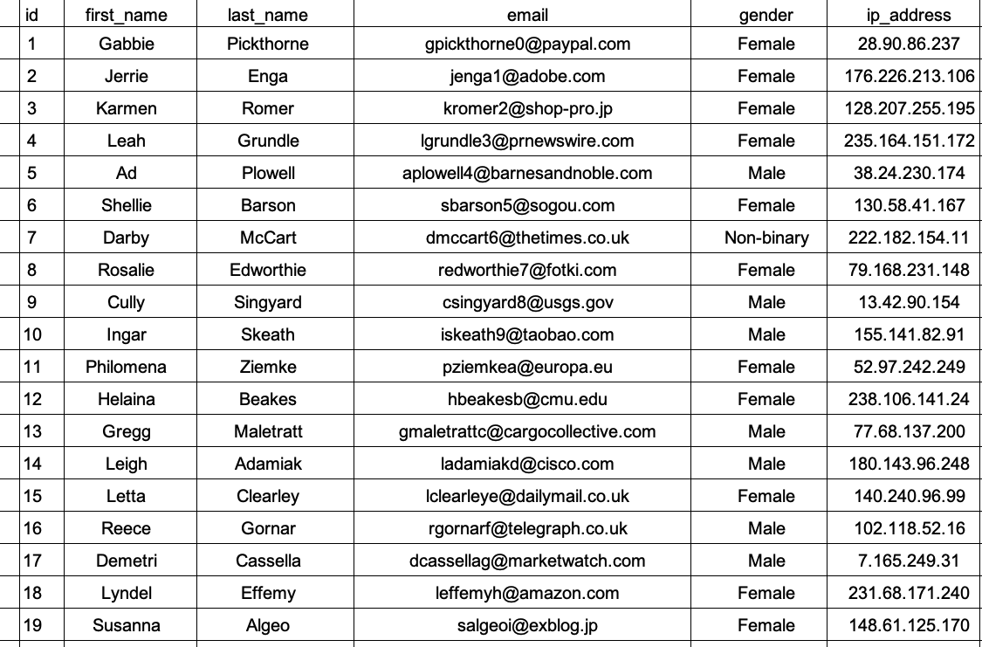
01
TSR
TSR
Classifier
Input image
Classifier
Result

Slide 3

01
TSR
TSR
Classifier
Threshold : Image.width(height) * 0.85
Sum(image[line]) < threshold

Slide 4
01
TSR
TSR
Partially

